Slide 1
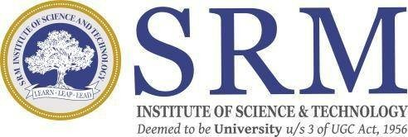
SRM INSTITUTE OF SCIENCE AND TECHNOLOGY SCHOOL OF COMPUTING
DEPARTMENT OF COMPUTER SCIENCE AND ENGINEERING
18CSP109L - MAJOR PROJECT
“AI NEXUS: A BLUEPRINT FOR MICROENTERPRISE BRILLIANCE”
Guide name: Dr. Avneesh Vashistha
Designation: Professor
Department: CSE
Batch ID: 24MP26030099
Reg. No:RA2011026030099
Name: Lahari Krishnam
Reg. No:RA2011026030116
Name: Smaranika Udgata
Reg. No:RA2011026030117
Name: Avantika Gupta
Reg. No:RA2011026030119
Name: Suraj Singh

Slide 2
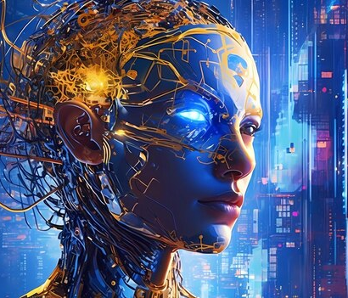

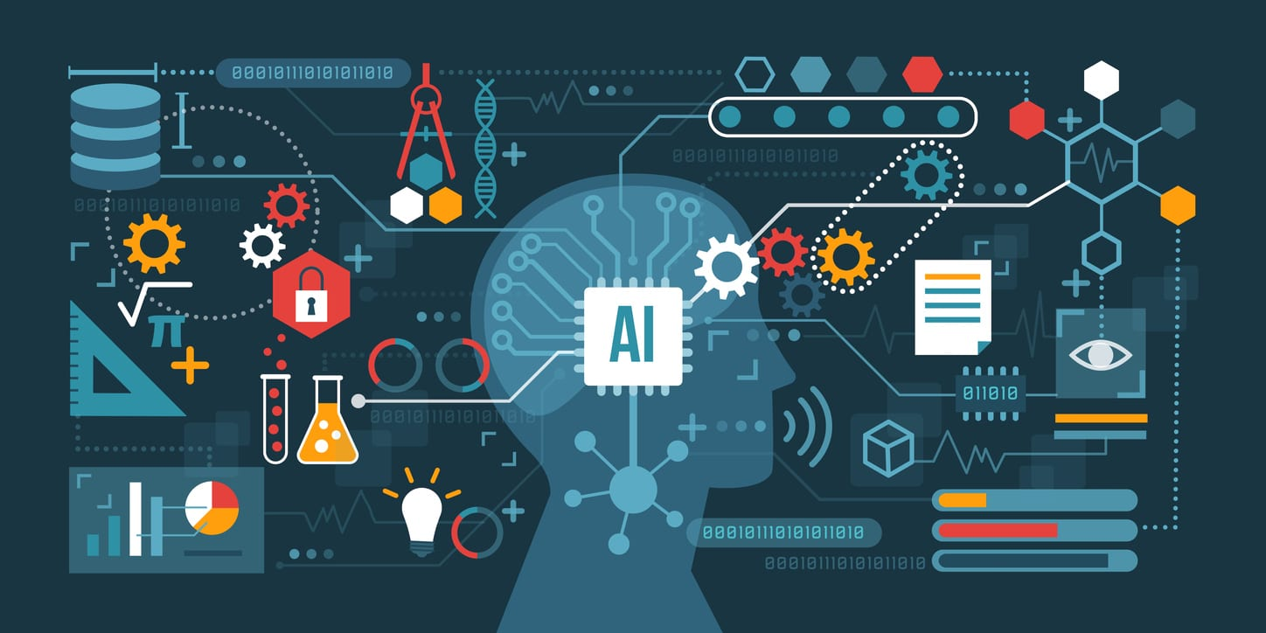
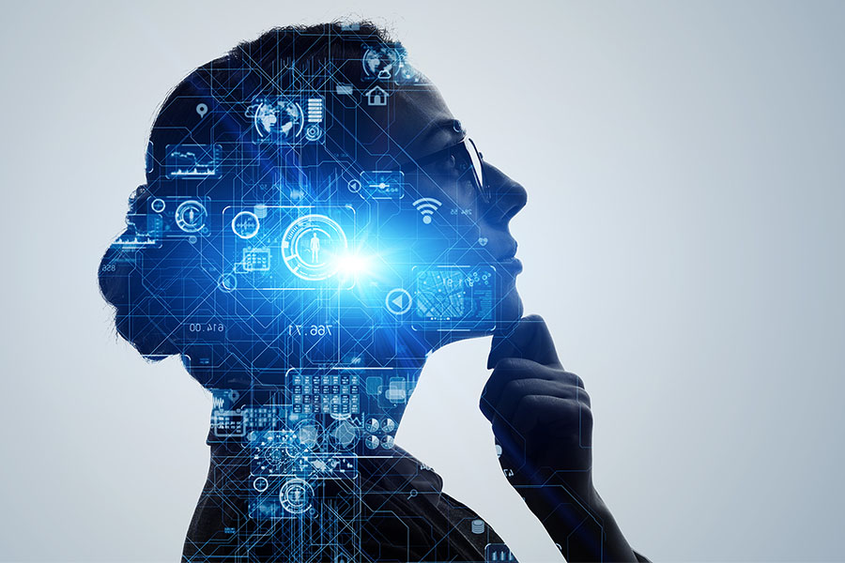

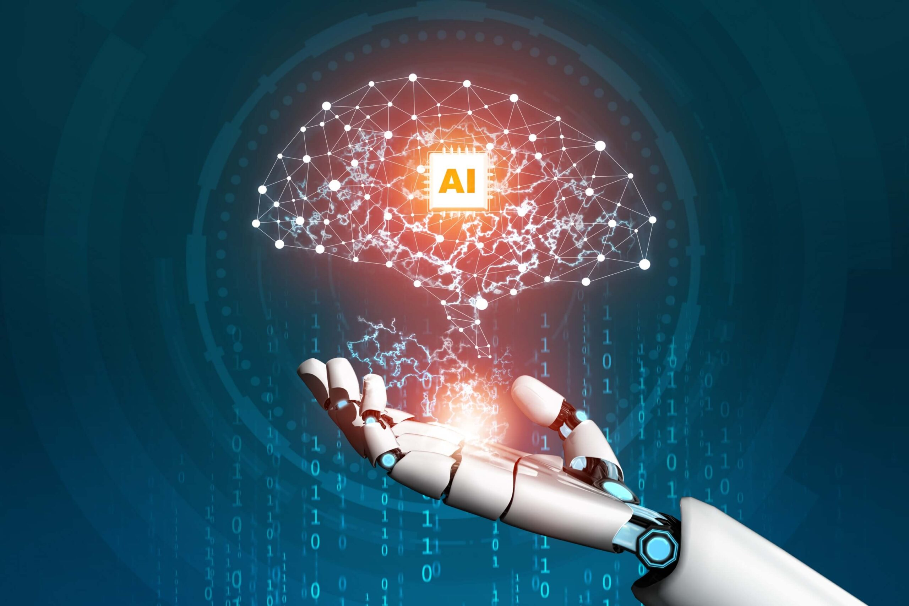
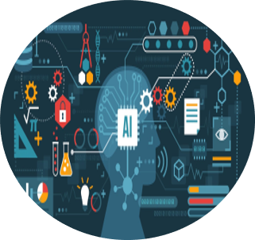
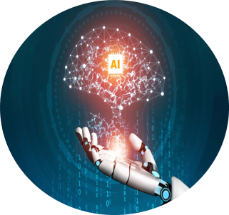



EXISTING PROBLEM
ABSTRACT
IMPLEMENTATION & RESULTS
PROPOSED SOLUTION
INTRODUCTION

Slide 3

ABSTRACT
Leveraging a fusion of cutting-edge machine learning (ML) methodologies and sophisticated natural language processing (NLP) algorithms, our project excels at swiftly analyzing and understanding user inquiries.
Integrating a Language Model (LM) with the robust capabilities of a K-Nearest Neighbors (KNN) algorithm, our system is designed to deliver tailored recommendations and actionable insights, efficiently addressing user queries.
Our project stands out by delivering precise problem-solving and curated tool recommendations, elevating the user experience by providing personalized solutions to their unique challenges.

Slide 4
INTRODUCTION
Welcome to our presentation on AI NEXUS which revolutionizes user experience through the seamless integration of advanced machine learning (ML) techniques and natural language processing (NLP) algorithms. In this session, we'll delve into how our project harnesses the power of cutting-edge technology to analyze and comprehend user queries effectively, paving the way for personalized recommendations and solutions.

Slide 5
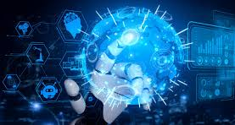
EXISTING PROBLEMS
Challenges faced:-
Reliance on manual intervention introduces inefficiencies.
Lack of sophisticated NLP algorithms and ML techniques hampers precision and personalization.
Inability to comprehend nuances in natural language communication.
Lack of ML-driven insights limits the system's capacity to learn and tailor responses.

Slide 6
PROBLEM STATEMENT
Microenterprises, integral to the economy, encounter obstacles in embracing evolving technologies, particularly Artificial Intelligence (AI). Despite AI's transformative potential, its integration presents formidable challenges for these businesses. The current body of literature fails to offer actionable insights into how microenterprises, characterized by industry-specific nuances and resource constraints, can strategically adopt and leverage AI for sustainable success.
Objective
To address this critical gap, our project endeavors to develop a customized framework. This framework aims to unlock AI's potential within microenterprises, fostering efficiency, innovation, and competitiveness in this vital sector.

Slide 7
PROPOSED SOLUTON
Empowering users with tailored solutions that leverage vast knowledge bases and adapt to individual preferences.
Revolutionizing the user experience by seamlessly integrating advanced ML and NLP techniques for enhanced accuracy and effectiveness.
Offering a transformative approach to problem-solving, characterized by adaptability, efficiency, and user-centric design.
Ensuring scalability and flexibility to accommodate evolving user needs and technological advancements in ML and NLP fields.

Slide 8
METHODOLOGY
Problem Identification and Data Collection: Identify challenges and gather comprehensive data.
Preprocessing and Feature Extraction: Clean, transform data, and extract relevant features.
Machine Learning Model Development: Select, train, and optimize models for microenterprise solutions.
NLP Integration: Utilize advanced NLP algorithms for text analysis and understanding.
KNN Algorithm Integration: Incorporate KNN for personalized recommendation systems.
Ethical AI and Bias Mitigation: Establish frameworks and mitigate biases in AI algorithms.
Iterative Development and Refinement: Employa agile méthodologies to facilitante continuos improvisent.
Documentation and Knowledge Sharing: Document processes and share insights for transparency and collaboration.

Slide 9
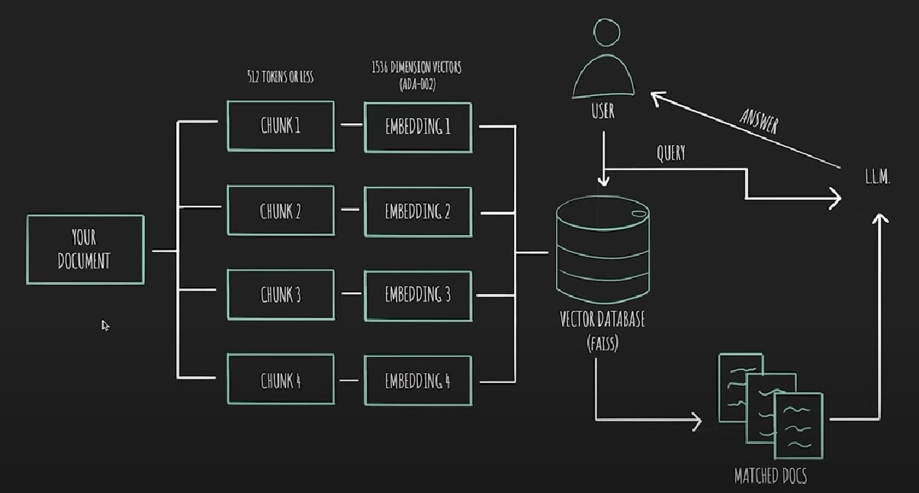
Architecture Diagram

Slide 10
IMPLEMENTATION & RESULTS
Implementation
Result
Utilizing K-Nearest Neighbors (KNN) Algorithm:
Implement KNN algorithm to create personalized recommendation systems tailored to microenterprise challenges.
Leverage KNN's ability to classify similar data points to provide relevant and targeted solutions for users.
Integrating Language Model (LM):
Implement a Language Model (LM) to analyze and comprehend user queries effectively.
Utilize LM's understanding of natural language to provide accurate and contextually relevant responses to user inquiries within microenterprise contexts.
our project successfully provided solutions for user queries by leveraging a combination of AI tools tailored to microenterprise needs. By integrating diverse AI methodologies such as K-Nearest Neighbors (KNN) for personalized recommendations and Language Models (LM) for accurate query comprehension, our system effectively addressed user inquiries. This multifaceted approach ensured that users received comprehensive and efficient solutions, showcasing the versatility and efficacy of AI in enhancing problem-solving capabilities within microenterprise settings.

Slide 11
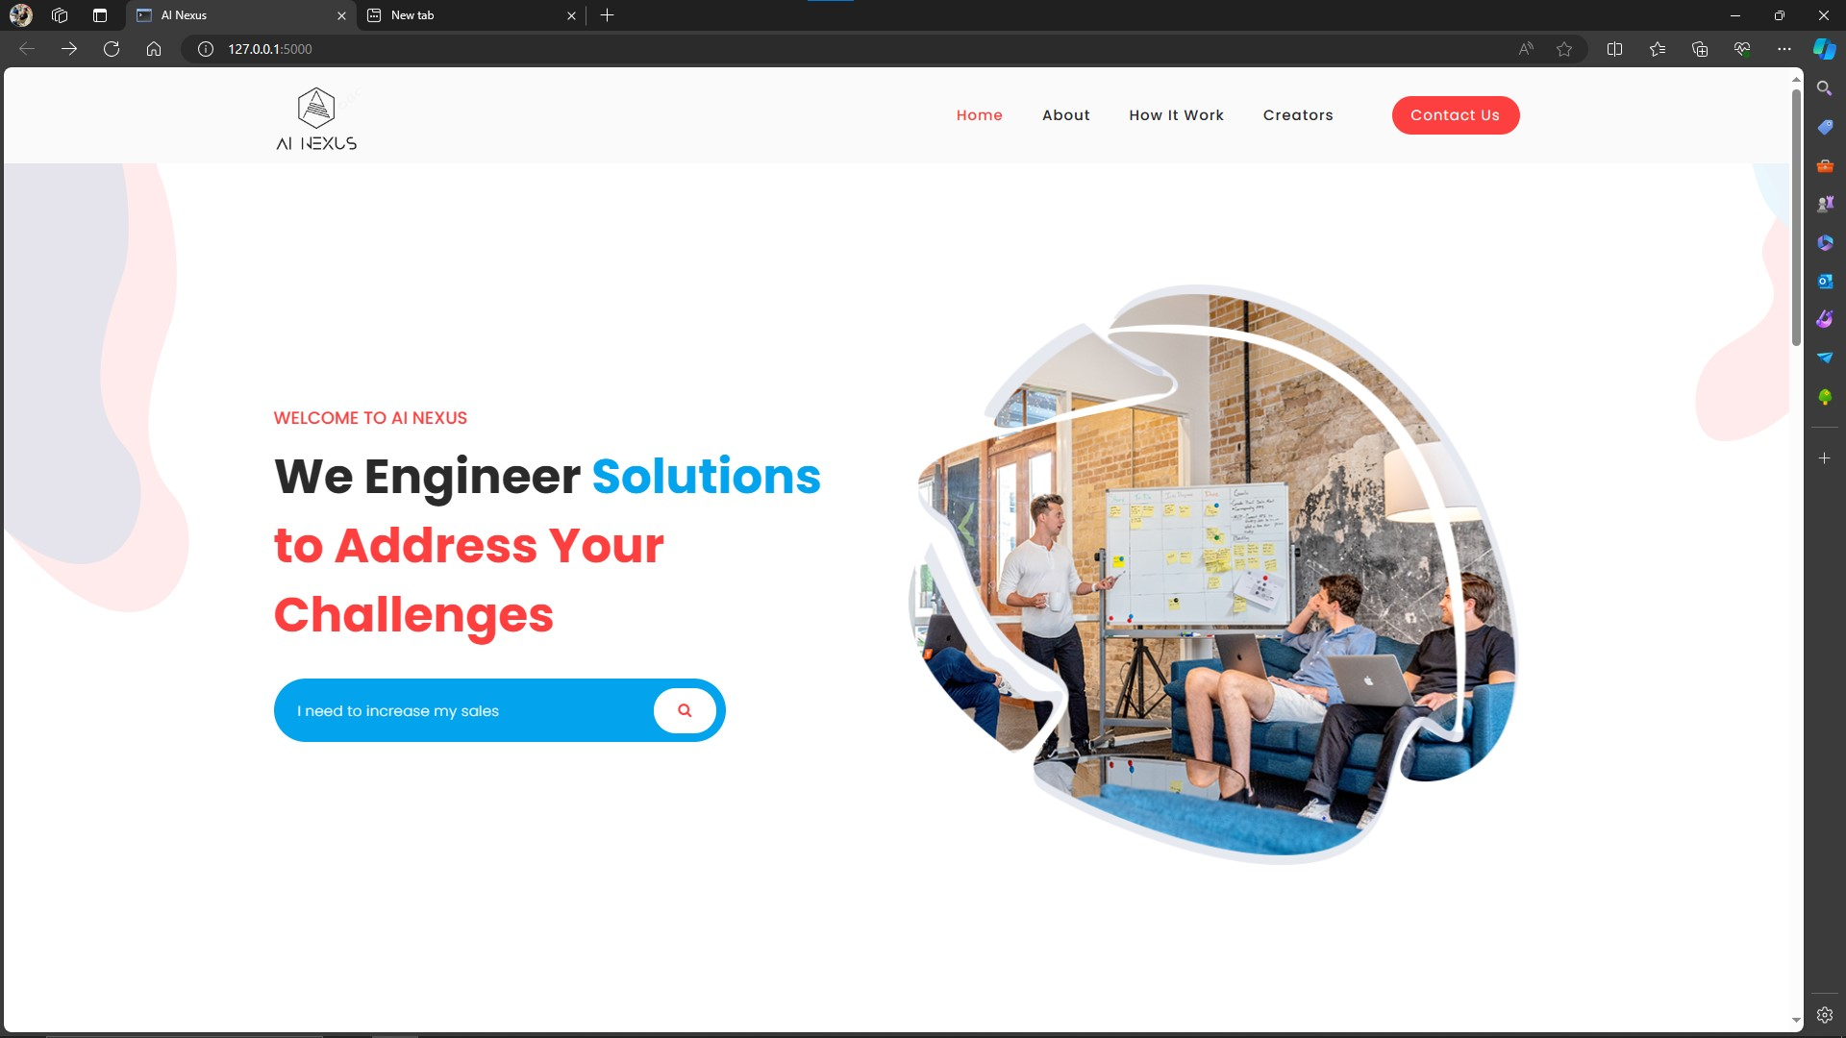
Input

Slide 12
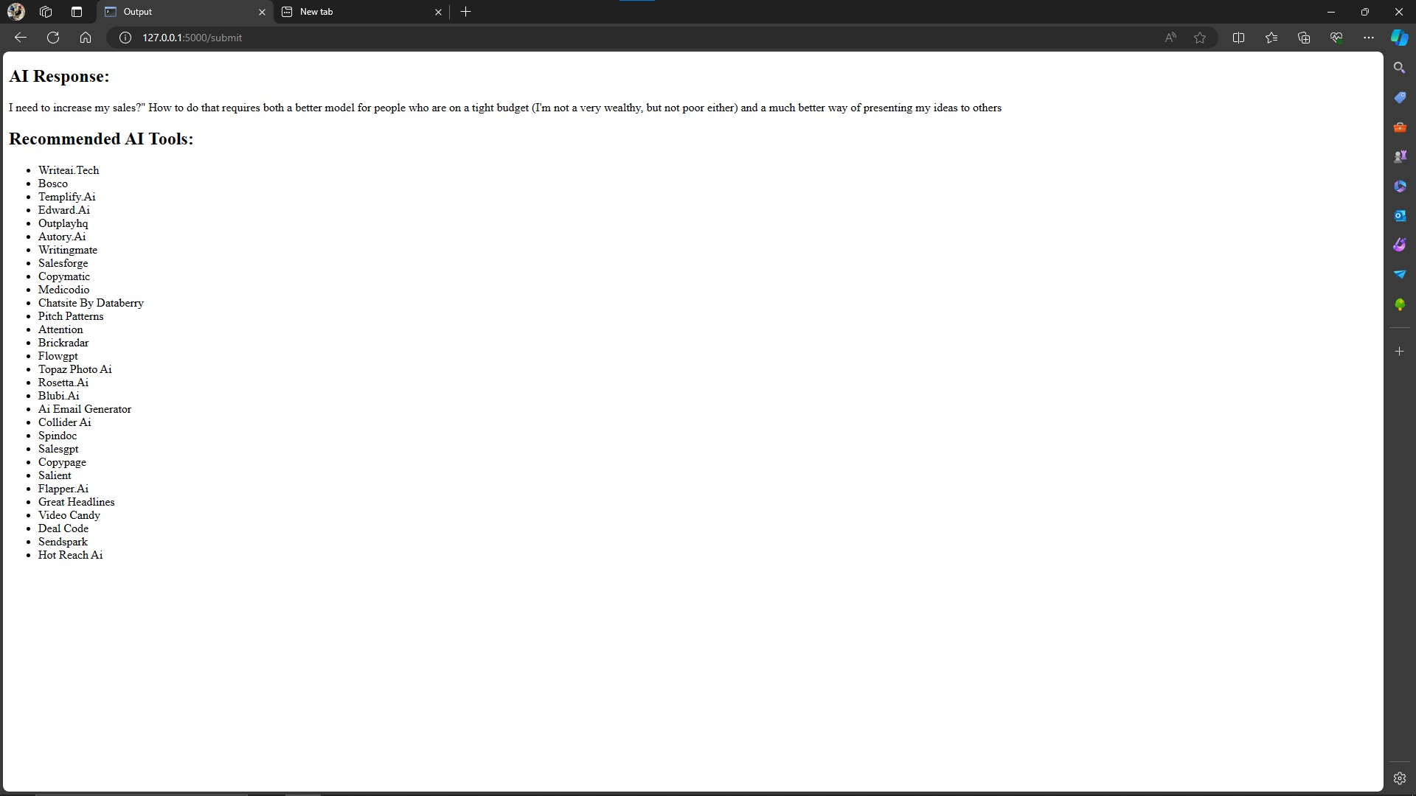

Slide 13
REFERENCES
Radford, A., Narasimhan, K., Salimans, T., & Sutskever, I. (2018). "GPT (Generative Pre-Training) - Improving Language Understanding by Generative Pre-Training". OpenAI Blog. Retrieved from
Yang, Z., Dai, Z., Yang, Y., Carbonell, J., Salakhutdinov, R., & Le, Q. V. (2019). "XLNet: Generalized Autoregressive Pretraining for Language Understanding". arXiv preprint arXiv:1906.08237.
Dong, L., Yang, N., Wang, W., Wei, F., Liu, X., Wang, Y., ... & Gao, J. (2019). "UniLM: Unified Language Model Pre-training". arXiv preprint arXiv:1905.03197.

Slide 14
THANK YOU!

